Slide 1
Data & Cloud Skill Up and Exam Ready Workshop Exam 70-535: Architecting Azure Solutions

Slide 2
Agenda – Day 1
Time | Speaker | Topic | Link to slides
8:30 AM |  | Registration and Breakfast
9:00 AM | David Peterson | Welcome Remarks & Agenda Overview
9:15 AM | Brian Keyes | DevOps
10:30 AM |  | Break
10:45 AM | Allen Brokken | Design Data Implementation
12:00 PM |  | Lunch
1:00 PM | David Peterson | Design for Azure Resource Manager Networking
2:15 PM |  | Break
2:30 PM | Allen Brokken | Design Compute Infrastructure
3:45 PM |  | Making it Real with Practical Application - Open Discussion
4:30 PM |  | Close for the day

Slide 3
Agenda – Day 2
Time | Speaker | Topic | Link to slides
8:30 AM |  | Registration and Breakfast
9:00 AM | David Peterson | Day 1 Recap & Agenda Overview
9:15 AM | Allen Brokken | Design Security & Identity Solutions
10:30 AM |  | Break
10:45 AM | David Peterson | Design Solutions by using Platform Services (Part 1)
12:00 PM |  | Lunch
1:00 PM | David Peterson | Design Solutions by using Platform Services (Part 2)
2:15 PM |  | Break
2:30 PM | Brady Randolph | Design for Operational Readiness
3:45 PM |  | Making it Real with Practical Application - Open Discussion
4:30 PM |  | Close for the day

Slide 4
Setting Expectations

Slide 5
What to expect the next two days
The next two days are designed to help you pass the 70-535 exam
This content lays the foundation – DO NOT expect to take and pass exam with just these two days of overview
Lab materials are available to help reinforce this content
Free Azure trial: https://azure.microsoft.com/en-us/free/
Feel free to ask questions; make this conversational
We are here to help!

Slide 6
Exam Information
Know what is in scope for the exam

Slide 7
RoadMap – Azure Certifications
MCSA – Cloud Platform, pass two of the following exams
70-473 Designing and Implementing Cloud Data Platform Solutions
70-475 Designing and Implementing Big Data Analytics Solutions
70-532 Developing Microsoft Azure Solutions
70-533 Implementing Microsoft Azure Infrastructure Solutions
70-535 Architecting Microsoft Azure Solutions
MCSE – Cloud Platform and Infrastructure
Requires MCSA – Cloud Platform
Pass one additional exam including: 70-246, 70-247, 70-413, 70-414, 70-473, 70-475, 70-532, 70-533, 70-535, 70-744

Slide 8
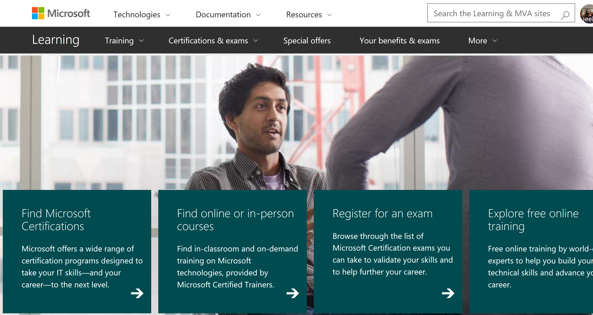
Consult the Official Exam Page for Your Exam
The exam page is the single point of truth for exam information.

Slide 9
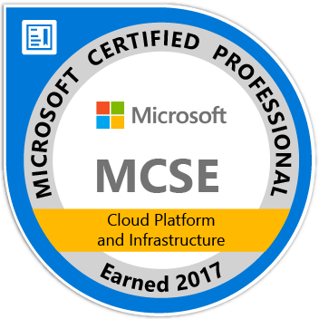
Azure Exam Refreshes
Exams are refreshed regularly
The MS Learning exam page announces significant changes before changes go live
You can now re-earn specific certifications yearly
“Since the last exam update, Microsoft Azure has had significant technology changes, and we are updating the exam objectives to include them. As of November 22, 2016, this exam reflects these changes.”

Slide 10
Question Types
How Exam Authors Ask Questions
Notes:
- Learn about a8 and a9 - hpc

Slide 11
Multiple Choice and Variants
1, 2, or 3 correct answers
Dynamic Option Multiple Choice is relatively new

Slide 12
Case Studies
Testlet with background, requirements, and other resources, may include code, markup, PowerShell, etc.
Includes 1 or more related questions
Once you complete a case study section, you cannot return to it
Why? Real world situations
Strategy: Read all of the questions first, then read through the case study document.

Slide 13
Standard Multiple Choice Item
You are architecting a solution for a client.
You need to ensure that the key stakeholder buys in to the design.
What should you bring to the meeting?
Hammers
Junk Food
Money
Penny Candy

Slide 14
Dynamic Option Multiple Choice Item
You are architecting a solution for a client.
You need to ensure that the key stakeholder buys in to the design.
You bring penny candy to the meeting with the stakeholder.
Does the solution meet the goal?
Yes
No

Slide 15
Other Item Types
Select answer options and place them in the correct order
Drag answer options into a table, diagram, code, markup, or PowerShell
Analyze code, markup, ARM templates, PowerShell scripts to test your understanding

Slide 16
Set-Based Items
Groups of questions may be presented as sets.
Sets may share elements (scenario and/or answer choices).
Ability to return to sets or questions in a set may be restricted.

Slide 17
Get Ready and Take the Exam
Know what is in scope for the exam

Slide 18
Get Ready
Sign up for free Azure
Review the Certification Exam Overview: 70-535: Architecting Microsoft Azure Solutions (MVA)
Practice, practice, practice
Run virtual labs
Read up on what is new
Do not use brain dump sites – use practice tests instead
Special offer – Exam Replay
Notes:
https://azure.microsoft.com/en-us/free/?v=17.39a (12 months)
MVA 70-535 - https://mva.microsoft.com/en-US/training-courses/certification-exam-overview-70535-architecting-microsoft-azure-solutions-17406?l=2jFpjinjD_4806218965
VIRTUAL LABS - https://azure.microsoft.com/en-us/training/hands-on-labs/
Azure updates - https://azure.microsoft.com/en-us/updates/
Practice tests - https://www.mindhub.com/70-534-Architecting-Microsoft-Azure-Solutions-p/mu-70-534_p.htm&utm_source=microsoft&utm_medium=certpage&utm_campaign=msofficialpractice
Exam Replay - https://www.microsoft.com/en-us/learning/offers.aspx?intcmp=lexhpoffersmenubutton

Slide 19
Read the Entire Item
One word or number can make a difference.
Read the boilerplate text and instruction statements.
Exam items are not written with any intent to trick, obfuscate, or deceive.

Slide 20
Consult the Official Exam Page for Your Exam
The exam page is the single point of truth for exam information.

Slide 21
Save Money on Your Exams
The Special offers link lists current promotions and discount.

Slide 22
Leave Comments About Exam Questions
Deprecated technology
Question is confusing or unclear
Branding has changed
You really like a question
Typographical errors
Functionality issues

Slide 23
Additional Resources
Microsoft Learning home page
Microsoft Born to Learn site
Microsoft Technet Learning Resources
Microsoft Virtual Academy
Edx.org
MeasureUp

